Slide 1
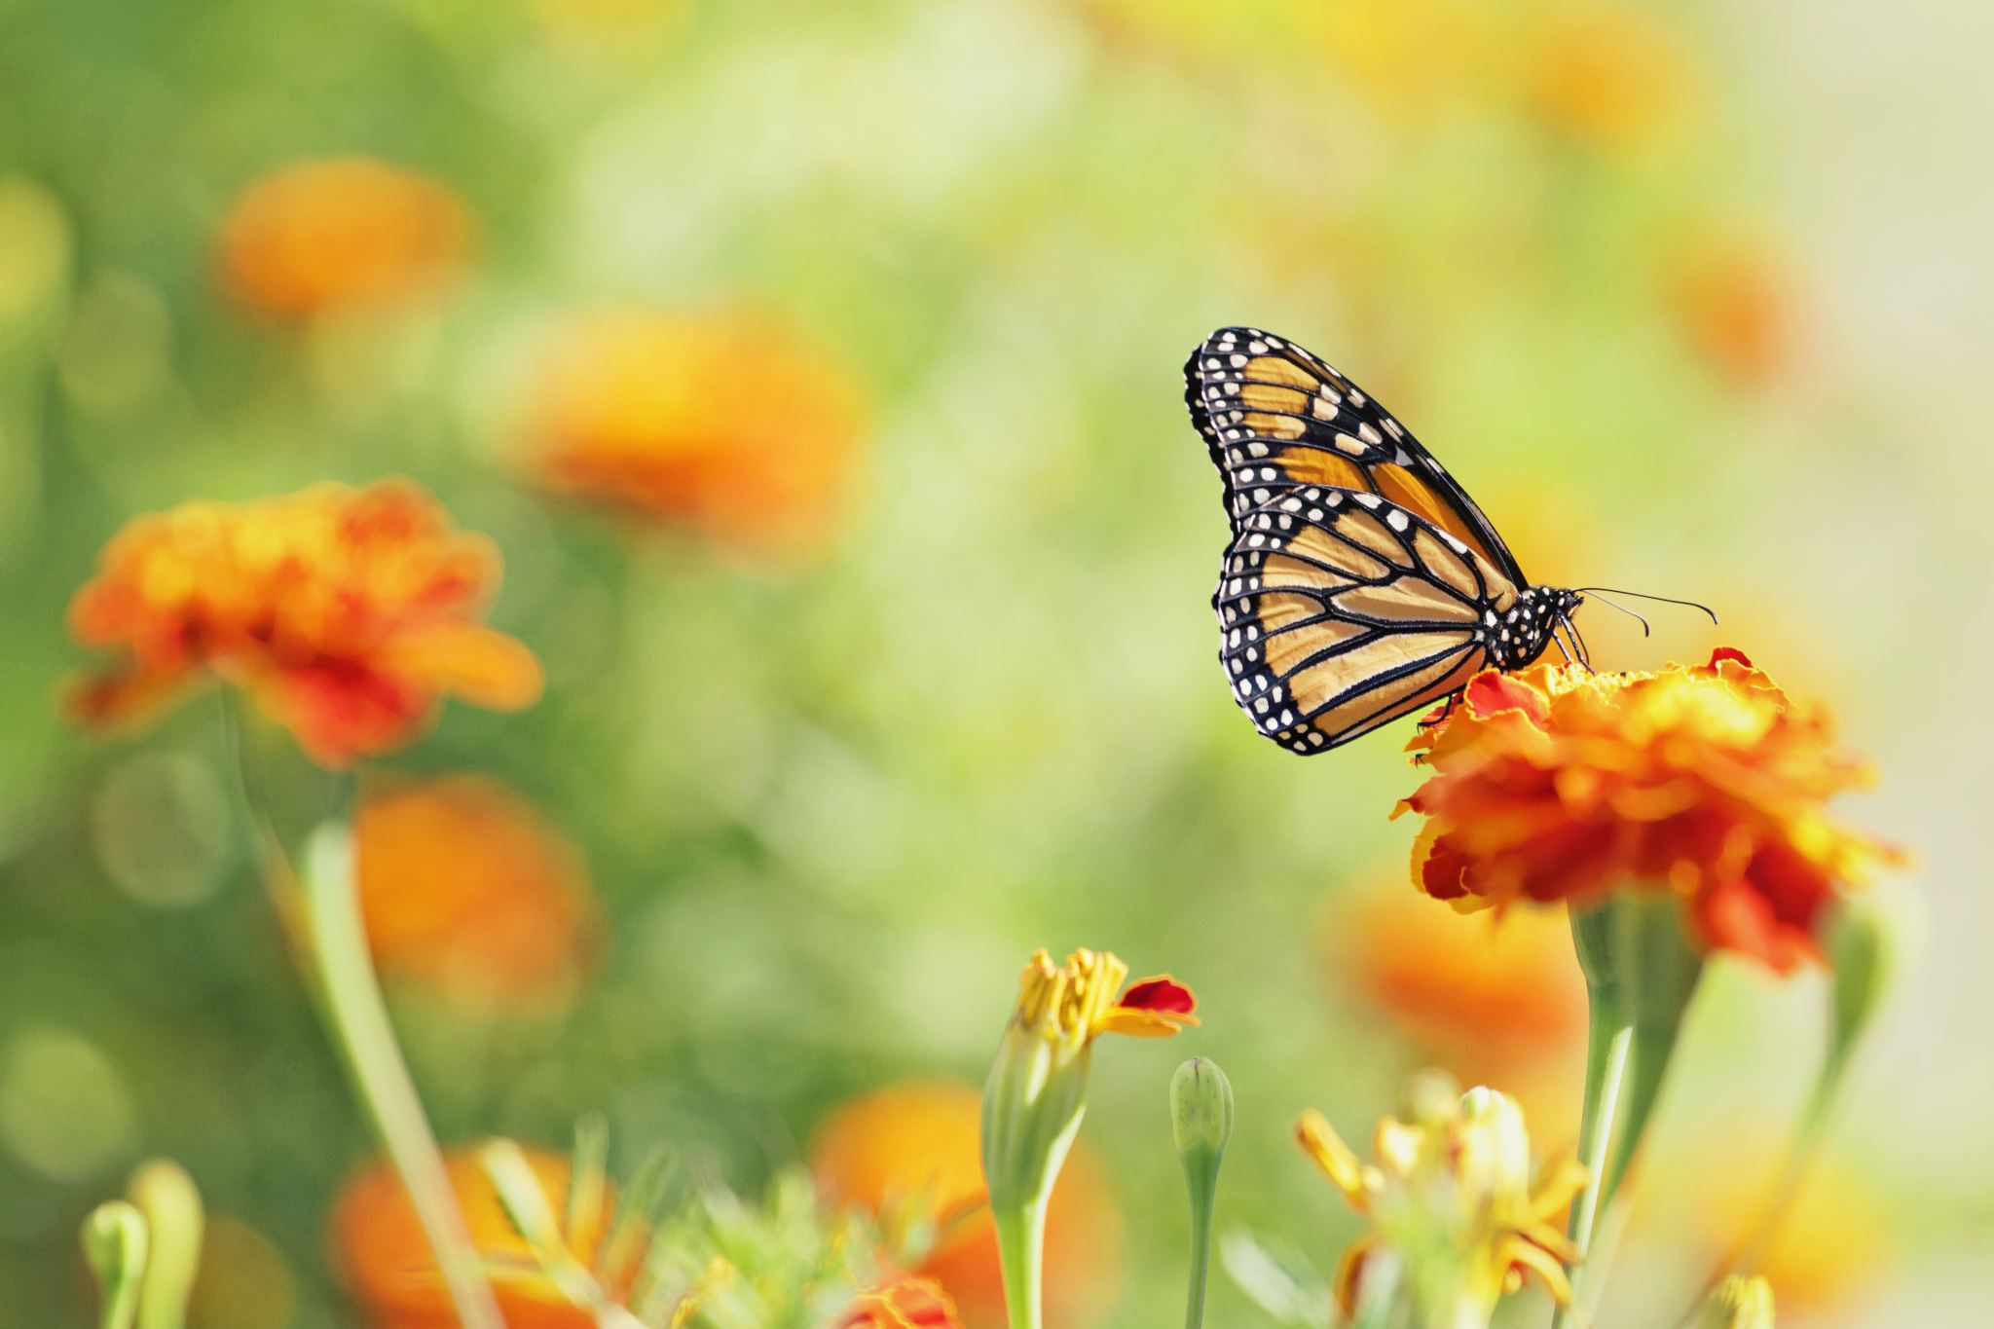
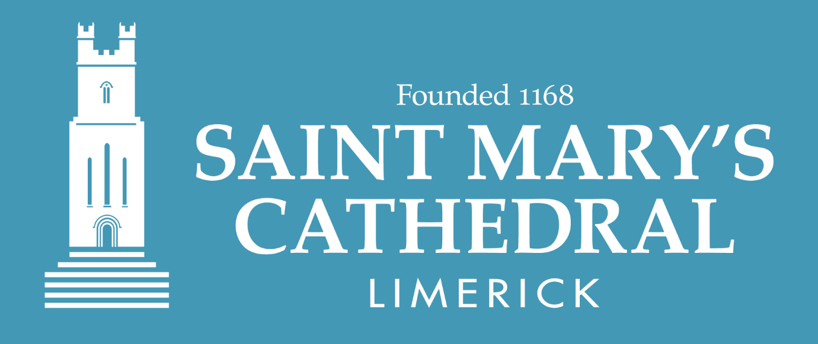
Free Lunchtime Concert
Tuesday 23rd July 1.15pm
St Mary’s Cathedral
Keith Matthews (tenor) and
Luke Lally Maguire (piano)
Music by Faure, Wagner, Lalo, Lambert, Britten and Schumann

